Slide 1


CS 6831 Designing Secure Cryptography
Tom Ristenpart

Slide 2

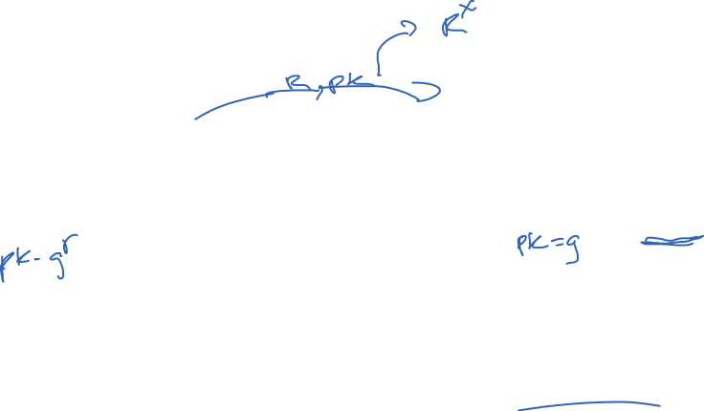
Schnorr ID scheme and signatures
R
r <-$ Z_{q}
R = g^{r}
c <-$ Z_{q}
c
Prover
Verifier
Knows sk = x
Knows pk = X = g^{x}
z = cx+r
If RX^{c} = g^{z} then Ret 1
Else Ret 0
Signature is commitment and response. Challenge generated non-interactively with RO
Works on other Sigma protocols as well
Sign(x, M )
r <-$ Z_{q}
R = g^{r} ; c = H(M || R) ; z = r + cx mod q
Return (R,z)
Ver(X, M, (R,z) )
c = H(M || R)
If g^{z} = RX^{c} then Return 1
Return 0

Slide 3

ID protocols and ZK protocols
R
R <-$ P.com(pk)
c <-$ C
c
Prover
Verifier
Knows sk = x
Knows pk = X = g^{x}
z
b <- V.ver(pk,R,c,z)
z <- P.resp(sk,R,c)
Sigma protocols one kind of zero-knowledge proof protocol

Slide 4
Zero-knowledge proofs
Prove knowledge of secret x without revealing any information about x
Introduced by Goldwasser, Micali, Rackoff
“The Knowledge Complexity of Interactive Proof-Systems”, 1989
Relations:
Sigma protocols can be defined relative to relations
Witnesses
Statements

Slide 5
ID protocols and ZK protocols
R
R <-$ P.com(pk)
c <-$ C
c
Prover
Verifier
Knows sk = x
Knows pk = X = g^{x}
z
b <- V.ver(pk,R,c,z)
z <- P.resp(sk,R,c)

Slide 6
ID protocols and ZK protocols
R
R <-$ P.com(Y)
c <-$ C
c
Prover
Verifier
Knows witness x
Knows statement Y
z
b <- V.ver(Y,R,c,z)
z <- P.resp(x,R,c)
Benefit is that we can think about different relations, prove other kinds of statements
Fiat-Shamir transform yields non-interactive zero-knowledge proofs of knowledge

Slide 7
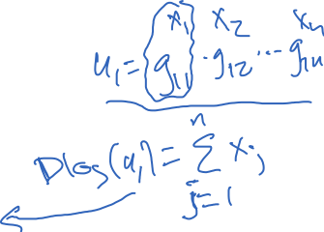
Sigma protocol for generalized linear relationships
Proving predicates of the following form:
Witness:
Statement includes u_{i} values and g_{ij} values
Witness is solution to sequence of m linear equations in exponent:
…

Slide 8
Sigma protocol for generalized linear relationships
Proving predicates of the following form:
Witness:
Statement includes u_{i} values and g_{ij} values
Examples:
Schnorr has n = 1, m = 1 and
Chaum-Pederson allows proving if a triple X,Y,Z is a DH triple, i.e., dlog(Z) = dlog(X)*dlog(Y)
n = 1, m = 2 and
Okamoto allows proving “representation” of dlog
n = 2, m = 1 and

Slide 9


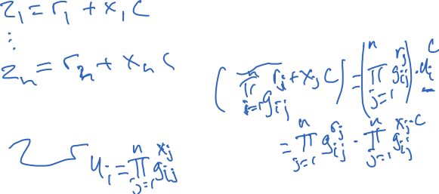
Sigma protocol for generalized linear relationships
c <-$ Z_{q}
c
Prover
Verifier
Knows
Knows
For i = 1 to m
Check for i = 1 to m that:
For j = 1 to n

Slide 10
Zero-knowledge properties
Completeness: can prove a true statement
Soundness: can’t prove a false statement
ZK proofs: no unbounded adversary can prove false statement
ZK arguments: no computationally bounded adversary can prove false statement
Knowledge soundness: to prove statement, prover must know a witness
Zero-knowledge: proof reveals nothing (except validity)
Perfect ZK: can simulate proofs with same distribution as real
Statistical ZK: simulated proofs statistically indistinguishable from real
Computational ZK: simulated proofs computationally indistinguishable from real
Concurrent ZK: simulation despite interleaved proof execution

Slide 11

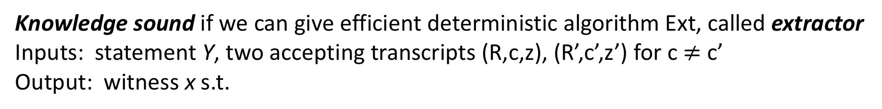
Knowledge soundness (for Sigma protocols)
Defined relative to Sigma protocol: P.com, P.resp, V.ver, challenge space C
Knowledge sound if we can give efficient deterministic algorithm Ext, called extractor
Inputs: statement Y, two accepting transcripts (R,c,z), (R’,c’,z’) for c $≠$ c’
Output: witness x s.t.
Generalized linear case Ext gets:
For j = 1 to n
For each x_{j} can solve pair of equations to extract

Slide 12

Special Honest-Verifier Zero-knowledge (for Sigma protocols)
Defined relative to Sigma protocol: P.com, P.resp, V.ver, challenge space C
Special HVZK if we can give efficient algorithm Sim, called simulator that for any (x,Y)
Inputs: statement Y, challenge c
Output: transcript (R,z)
It must hold that (1) (R,c,z) is valid transcript
(2) (R,c,z) distributed identically to honest transcript for random c
Same trick: choose z_{j} values randomly, then

Slide 13
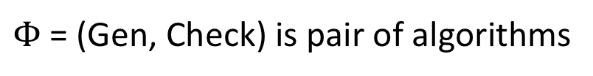

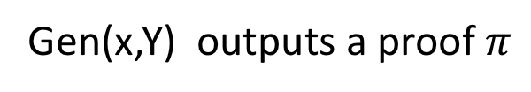

Non-interactive ZK Proofs
Fix a relation
$Φ$ = (Gen, Check) is pair of algorithms
Zero-knowledge:
Gen(x,Y) outputs a proof $π$
Check(Y, $π$) outputs a bit
“Plain” model, NIZK is impossible except for statements computationally easy to verify (i.e., in BPP)
Intuition:
Soundness implies Sim(Y) must fail if no x s.t.
Zero-knowledge implies Sim(Y) must succeed if x s.t.

Slide 14

Non-interactive ZK Proofs
Fix a relation
$Φ$ = (Gen, Check) is pair of algorithms
Zero-knowledge:
Gen(x,Y) outputs a proof $π$
Check(Y, $π$) outputs a bit
Can have NIZK in other models:
random oracle model
common reference string (CRS) model

Slide 15

Non-interactive ZK Proofs
Fix a relation
Zero-knowledge:
$Φ$ = (Gen, Check) is pair of algorithms
Gen(x,Y) outputs a proof $π$
Check(Y, $π$) outputs a bit
Can have NIZK in other models:
random oracle model
common reference string (CRS) model
Fiat-Shamir applied to our generalized linear equation protocol gives a NIZK POK

Slide 16

Application: proving encrypted message equality
Say we want to prove that two ciphertexts contain same message
Assume ElGamal encryption
Use our generalized equation Sigma protocol with n = 2, m = 3

Slide 17
NIZKs for General NP Languages
Can we build NIZKs for arbitrary statements?
Interactive proofs for NP long known [Goldreich, Micali, Wigderson 1991]
Protocol for proving knowledge of 3-coloring of graph
CRS-based NIZKs [Groth, Ostrovsky Sahai 2006]
Convert statement to circuit C
Bilinear-pairing based NIZK whose proofs are size O(|C|)
Groth 2010
Show how to do bilinear-pairing based scheme with constant size proofs.
Uses knowledge-of-exponent assumptions
zkSNARKs
More efficient representation than circuits: quadratic span programs
Then use Groth-style bilinear pairing proofs
Pinocchio system: 288 byte proofs of arbitrary programs

